Slide 1
Special Structures
Identify special structures
Describe the requirements for atriums
Explain the requirements for high-rise buildings

Slide 2
Historic Fire
Hartford Circus

Slide 3
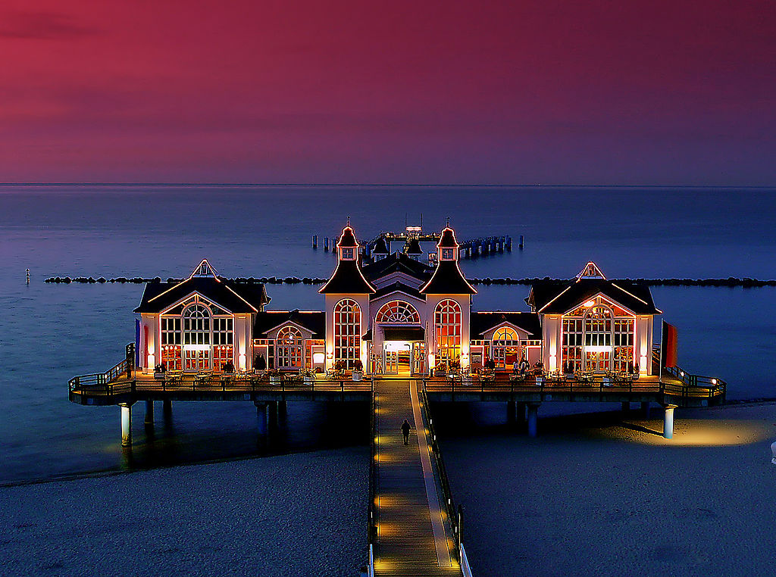
Special Structures
Multiple occupancies
Open structures
Towers
Water-surrounded structures
Piers
Vehicles and vessels
Underground structures
Permanent membrane structures
Temporary membrane structures
Tents

Slide 4
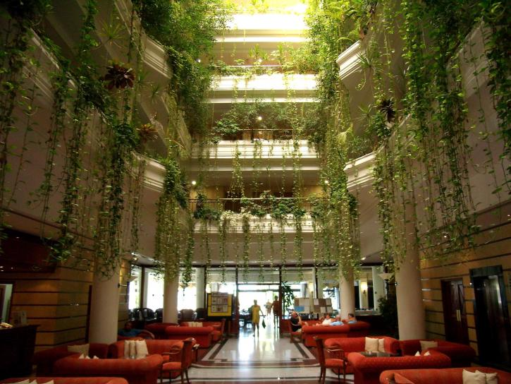
Atriums
Separated
  Glass walls: sprinklers within 12 in, cover entire surface
Sprinklered throughout
Smoke layer
  6 ft above highest floor level of exit access open to the atrium for greater of 1.5*egress time or 20 minutes

Slide 5
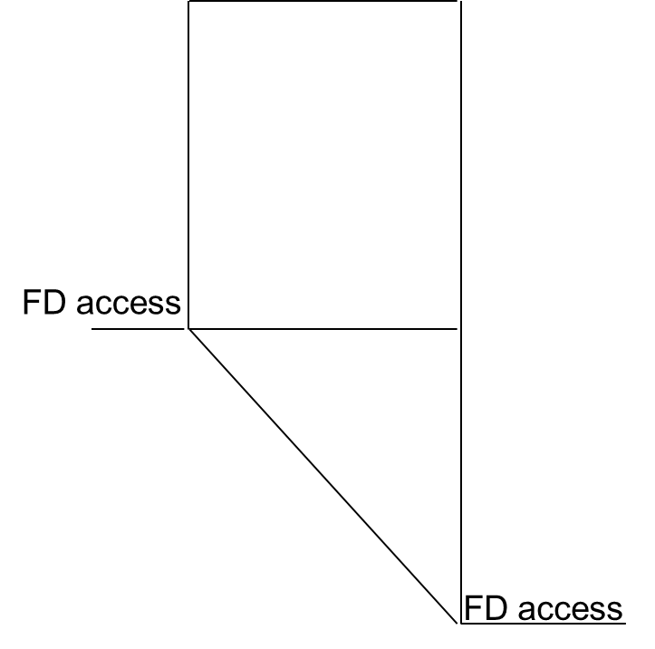
High-Rise Buildings
>75 ft above lowest level of fire department access
Sprinklers and standpipes
Voice alarm
Two-way telephone for fire department use
Additional emergency power requirements
Emergency action plan
Risk analysis

Slide 6
High-Rise Buildings
Emergency command center
  Status of fire protection systems
  Elevator status
  Emergency power status and control
  Able to use voice alarm system
  Two-way communication
  Stairway video monitoring equipment

Slide 7
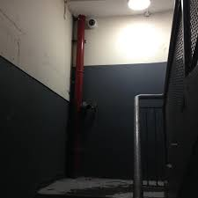
High-Rise in NFPA101
Every 5th floor unlocked from ingress side
  Minimum two re-entry doors
  One door within top two stories
Stairway video monitoring equipment
  Discharge floor
  Not exceeding 5 stories between cameras
Integrated testing
  Initial
  Every 10 years

Slide 8
High-Rise in IBC
Remoteness of stairs
  ¼ diagonal
  30 ft
Additional stair
  420 ft
2-way communication every 5th floor if doors locked

